Slide 1
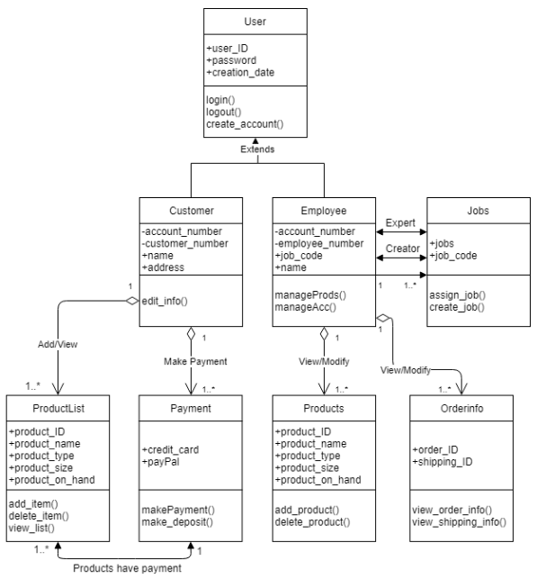
Expert and Creator
Employee is the expert of Jobs
- Responsible for assigning jobs
Employee is the creator of Jobs
- Employee will be responsible for creating job codes

